Slide 1

Savannah State University Division of University Advancement
Savannah State University
Phillip Adams
Vice President
STUDENT PORTAL
https://www.savannahstate.edu/students

Slide 2

About
Student Portal features include, but are not limited to the following:
View their enrollment related items in once place
Obtain up-to-date information on holds
View their classes and advisor information
Obtain updates on their key enrollment areas such as: Housing, Classes, and Bills etc…
Student specific announcements
Student will also be able to opt in to receive regular emails and text messages on their enrollment status and more….
Instructions: How to access the Student Portal:
The Student Portal URL is: http://www.savannahstate.edu/students/
Click the link just below the student login boxes labeled “admin login”. (Also this account can be reset by contacting the IT Helpdesk.)
Faculty/Staff would login using your Tigerworld username and password. (This is the same login used to login to your office computer.)
Student 915#s for review in the portal: 915155367, 915183293, 915152512, 915130938, 915170563
If you need assistance or having trouble logging in, please send an email to: saundersj@savannahstate.edu

Slide 3
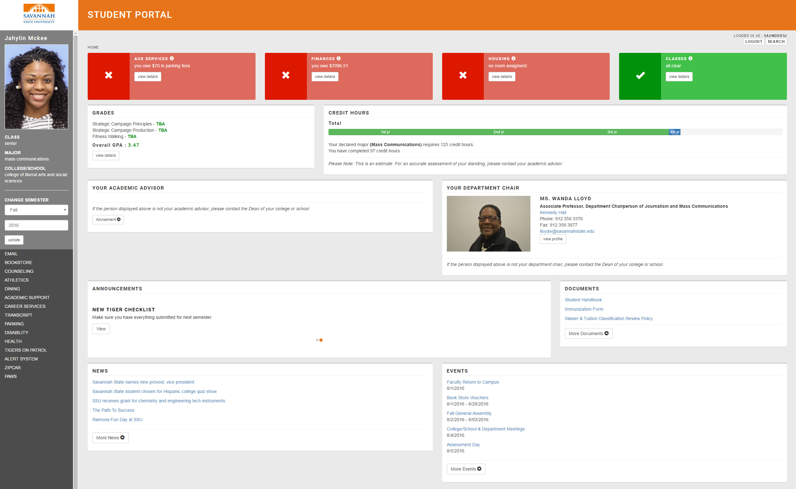
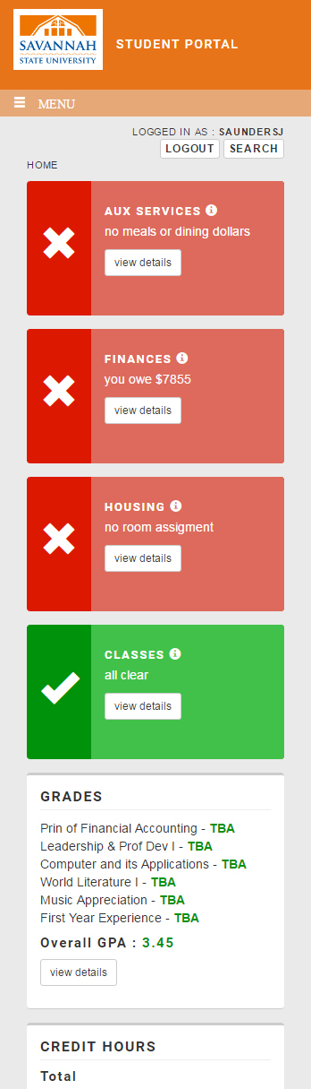
Homepage
Desktop version
Mobile version
When a student is logged in, they can quickly see if there are any areas that need to be addressed. Red areas signify actions that the student needs to take in order to meet enrollment, academic, or financial requirements. Additionally, there information about the student’s current courses, GPA, credit hours, academic advisor, and department chair.

Slide 4
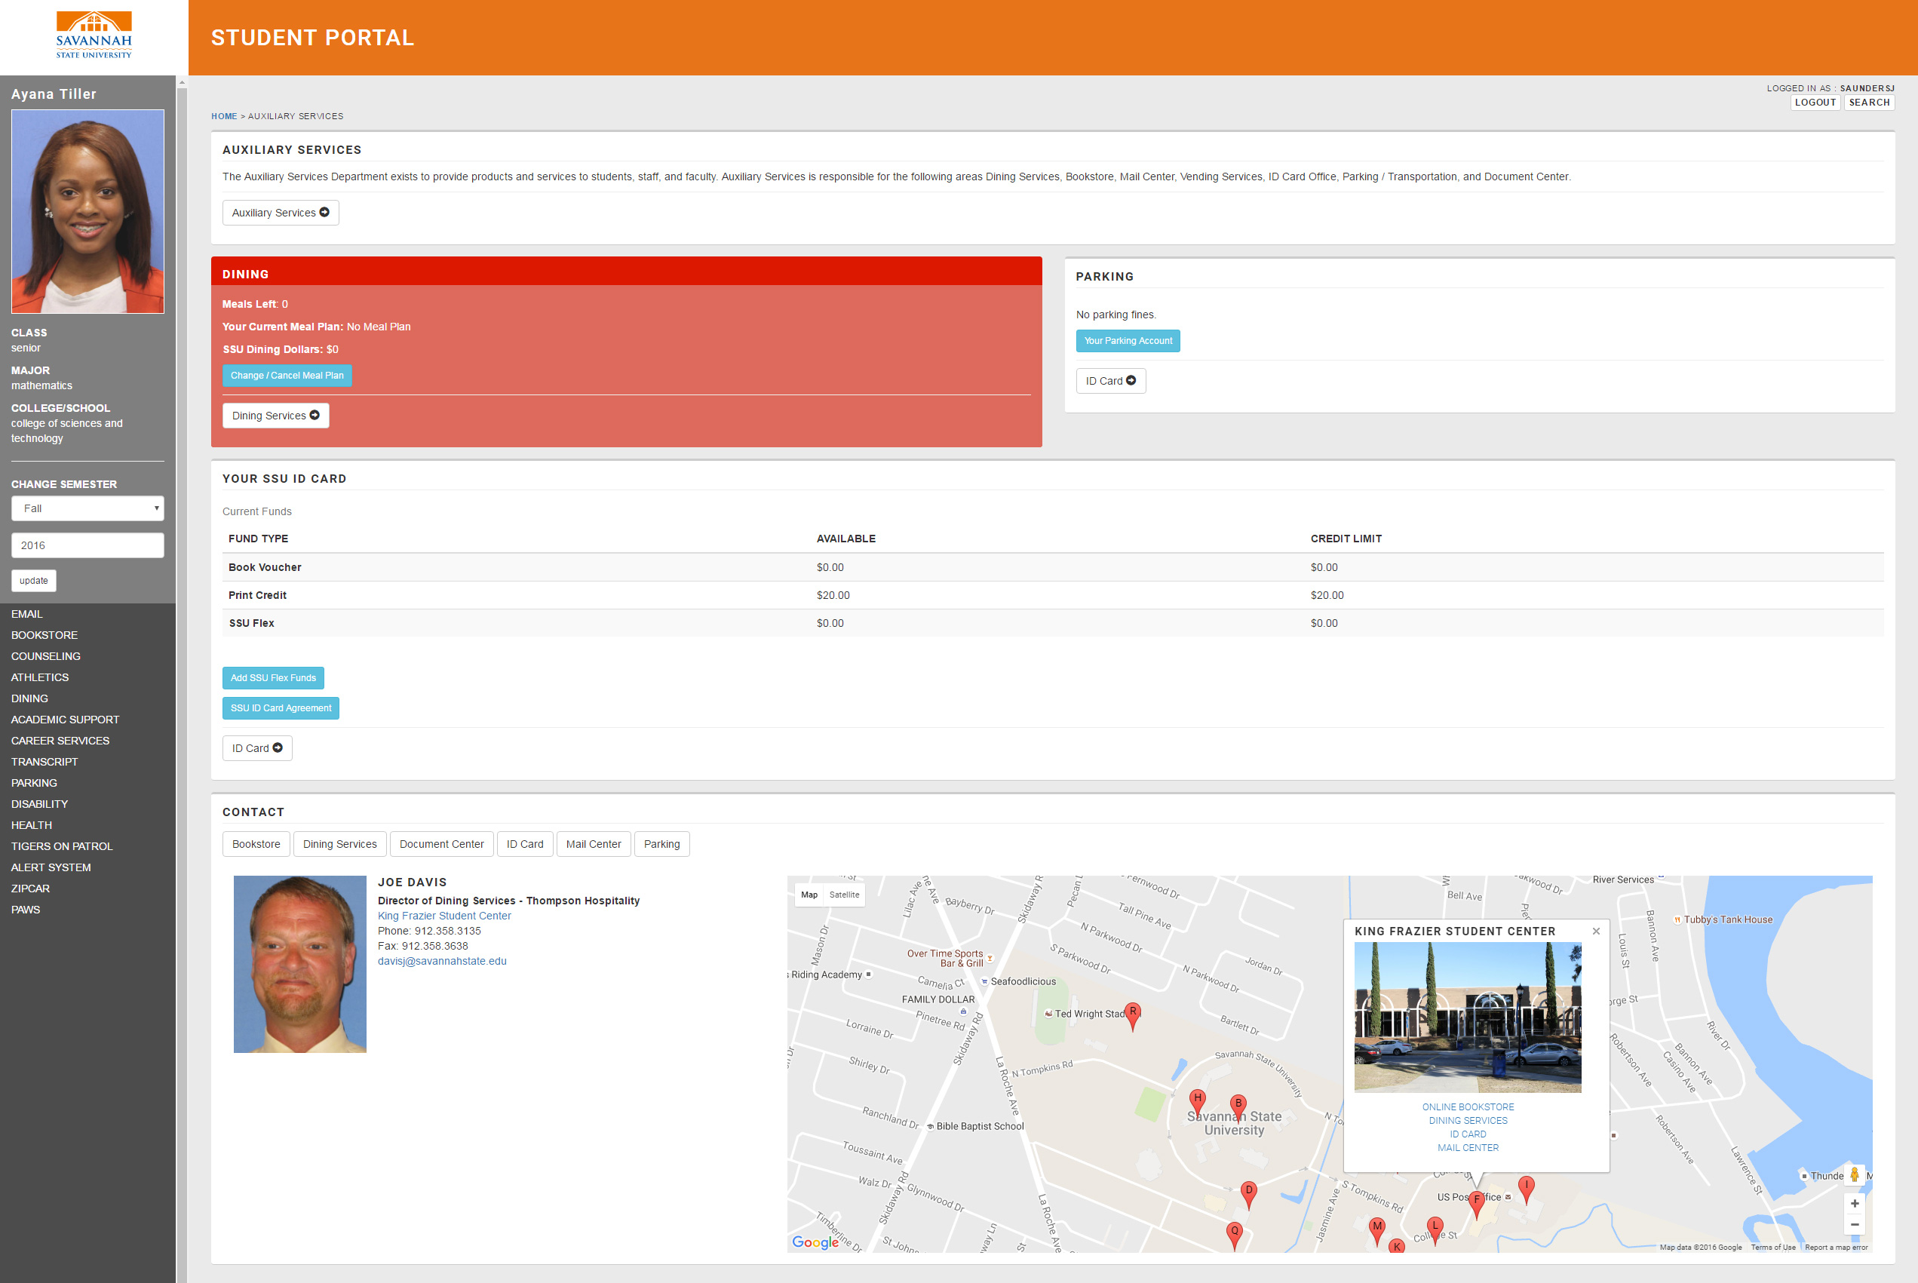
Auxiliary Services
In the auxiliary services area students can view information about their meal plan, parking fines, and balances on their SSU ID card. Contact information is provided for each of the departments listed.

Slide 5
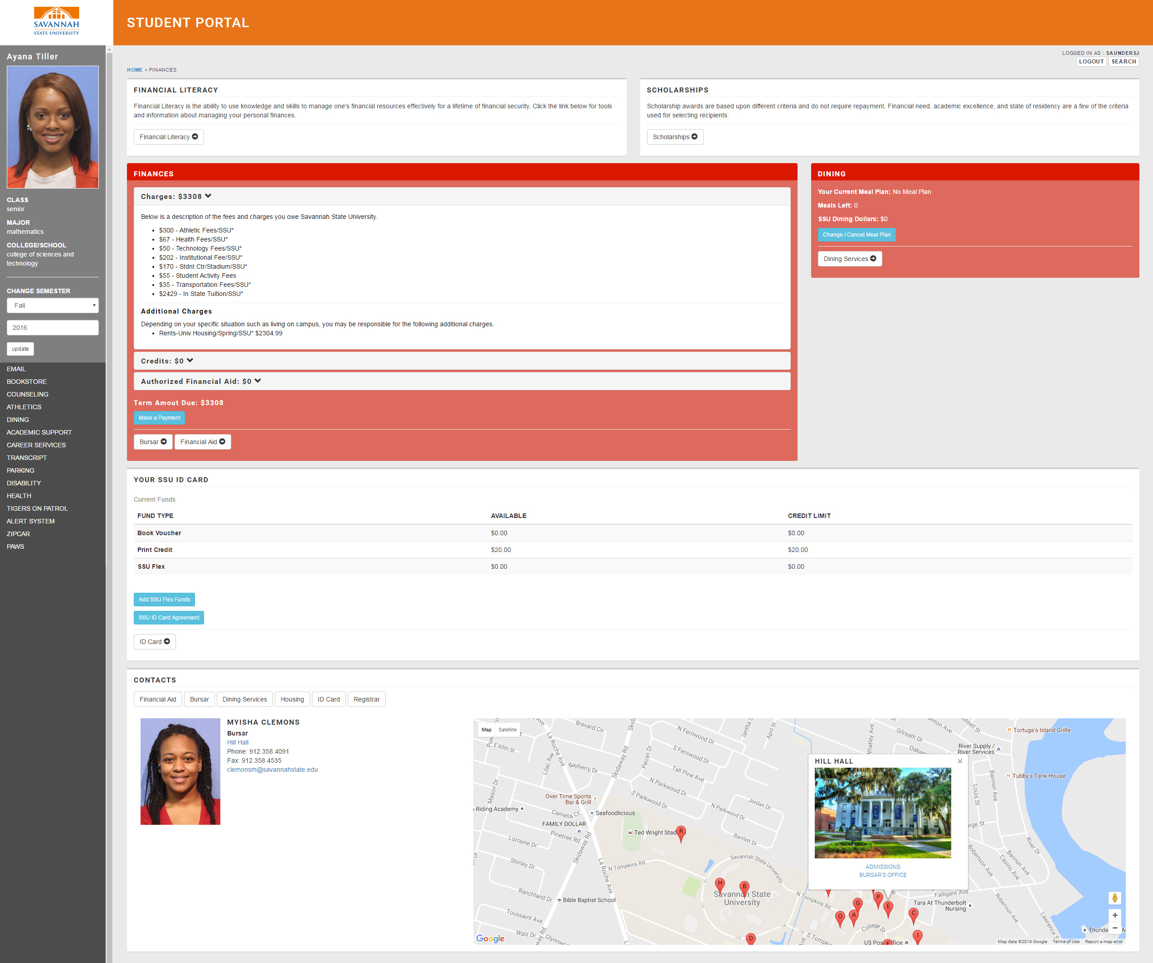
Finances
In the finances area students can view information about their current balances. Contact information is provided for each of the departments listed.

Slide 6
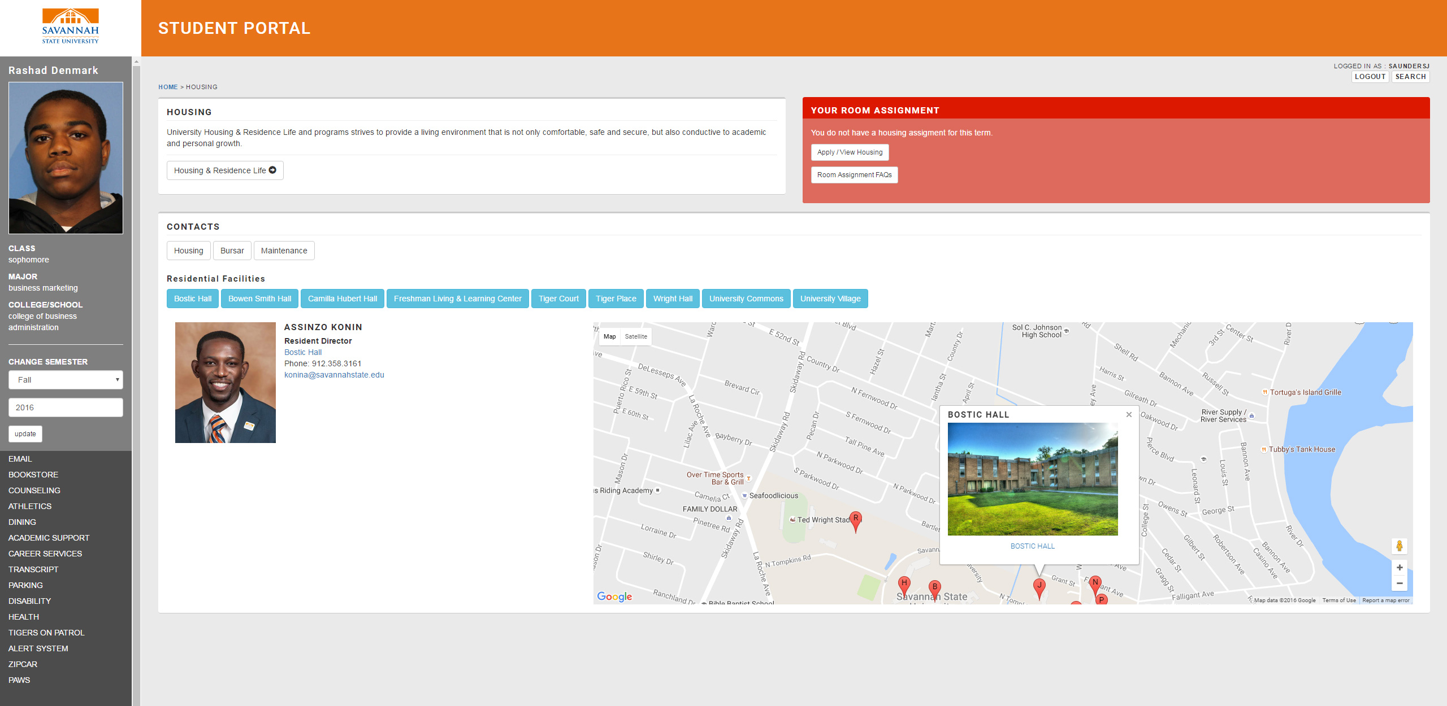
Housing
In the housing area students can view their current room assignment. Contact information is provided for each residence hall.

Slide 7
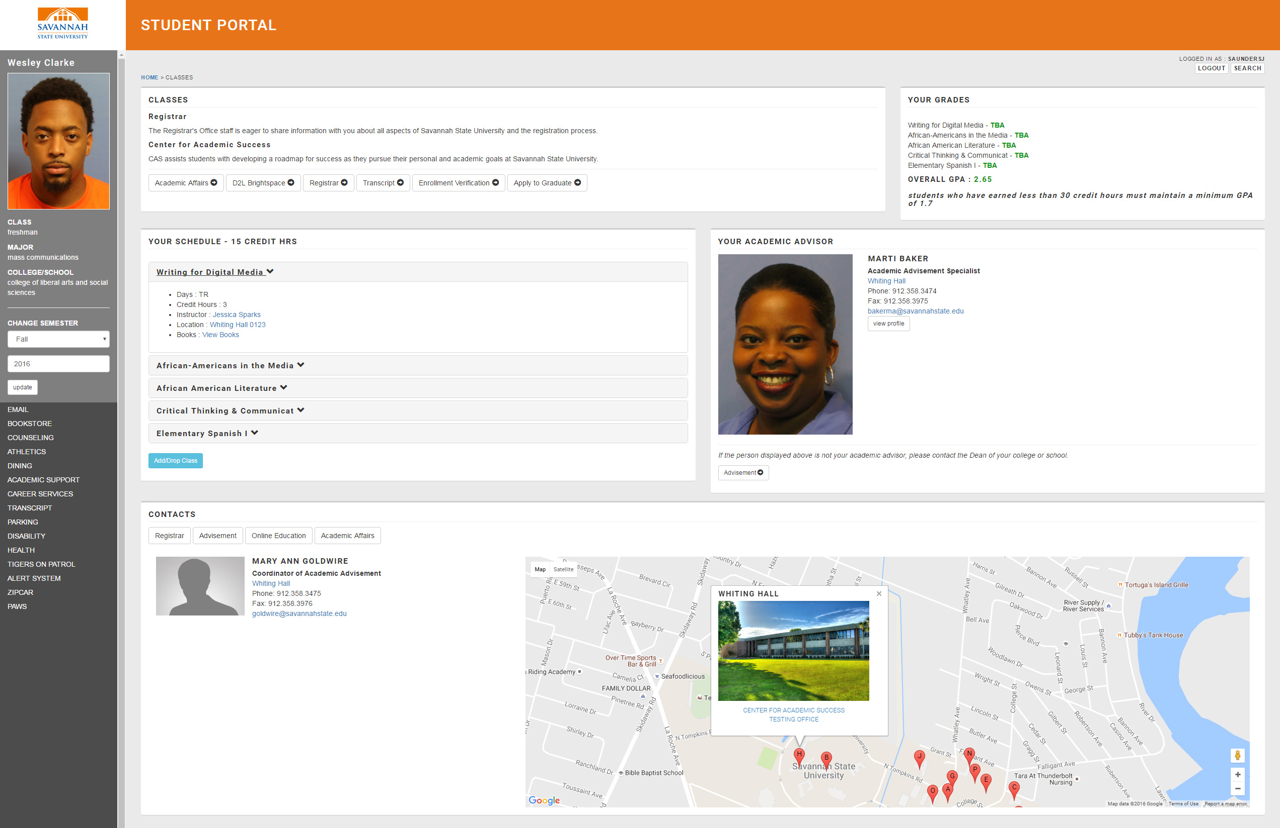
Classes
In the classes area students can view information about the classes they have enrolled in. This includes when the classes meet, links to the instructor, building, and textbooks. Course grades and contact information for academic advisement are also provided.

